Slide 1
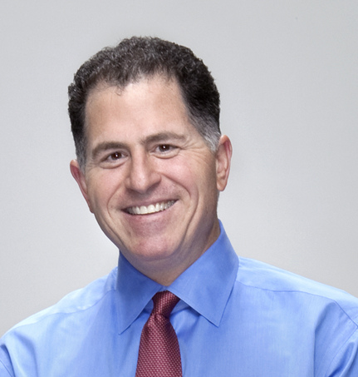
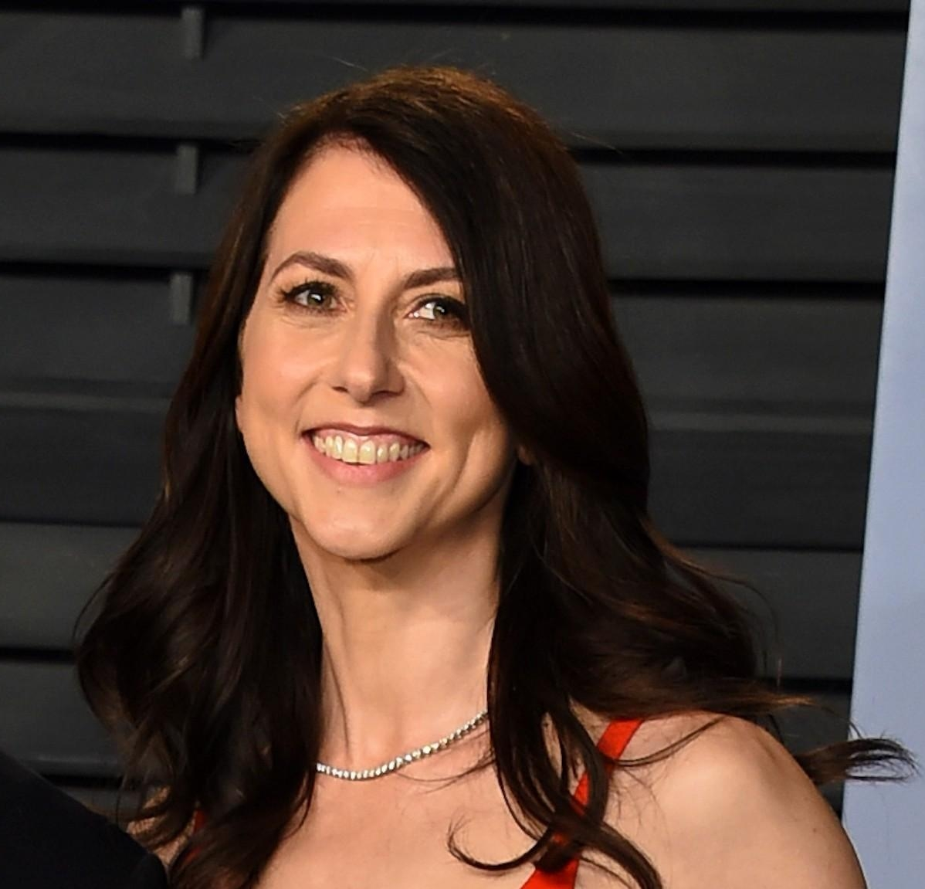
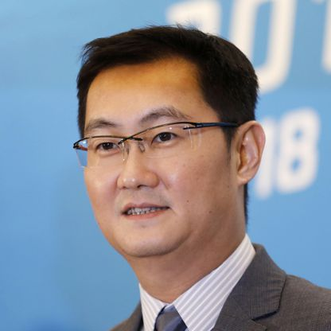
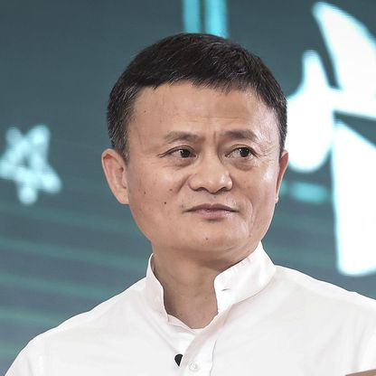
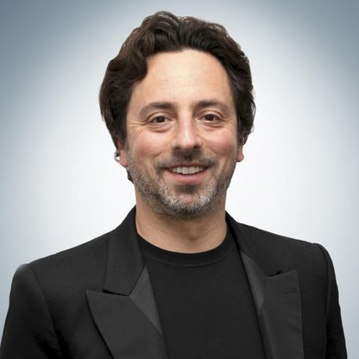
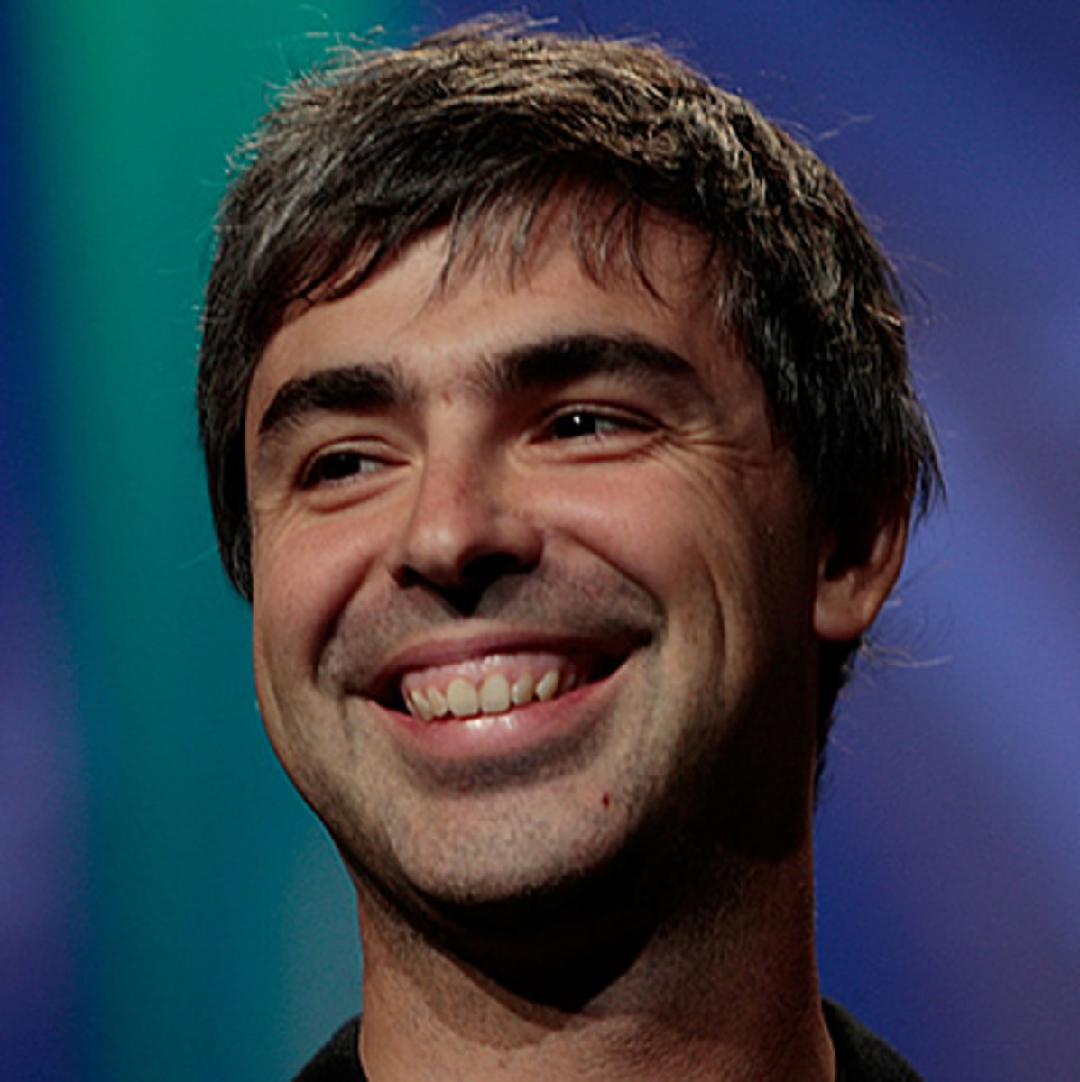
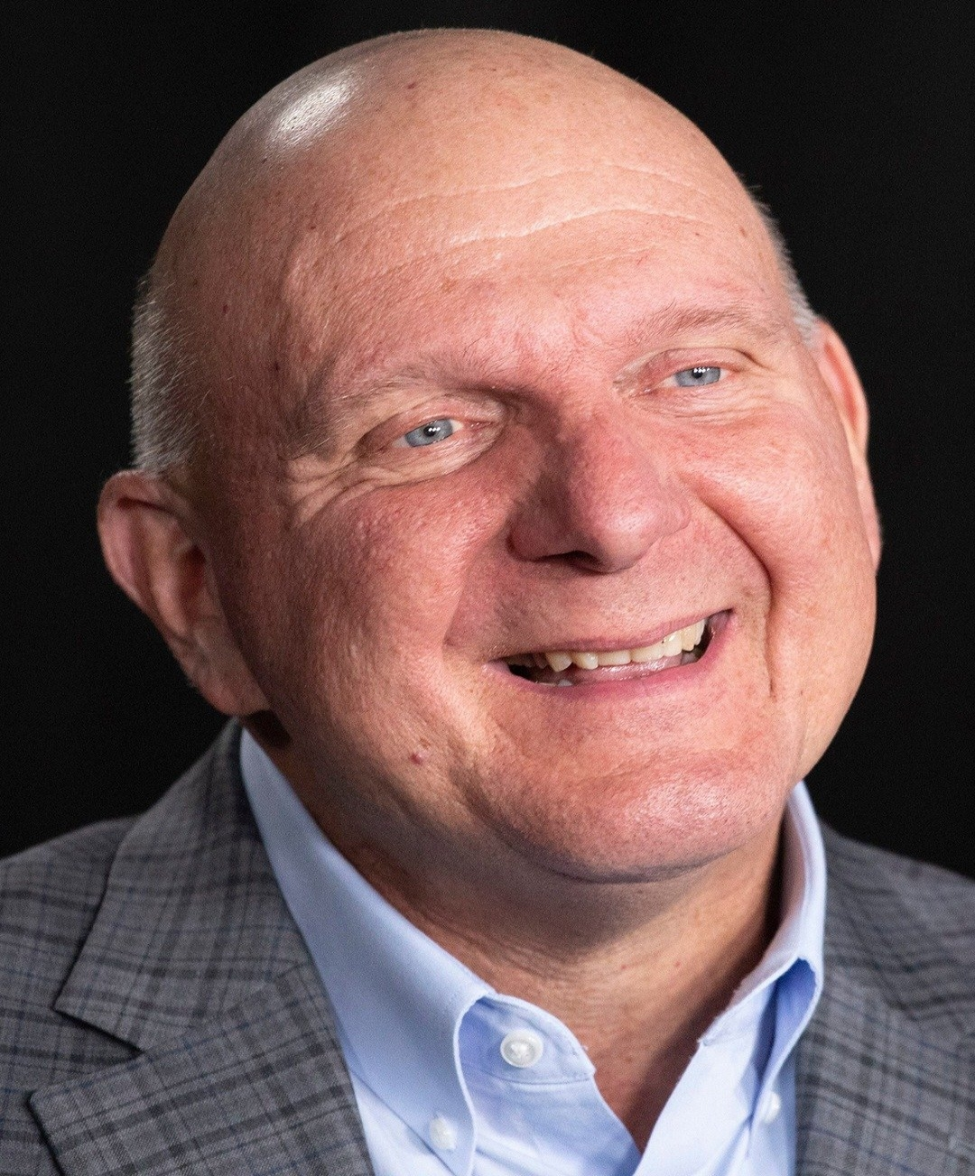
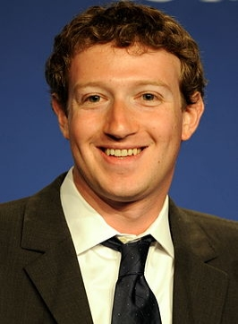
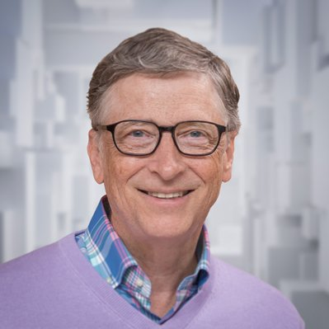
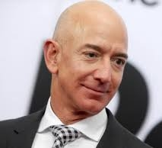
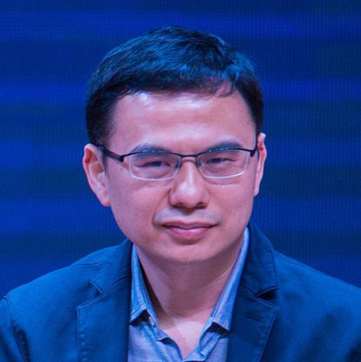

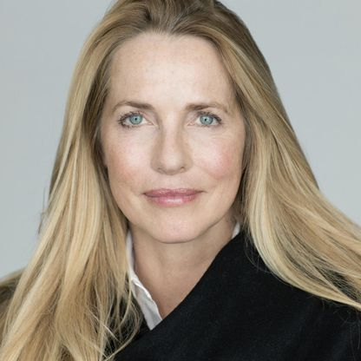
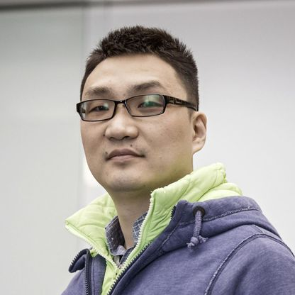
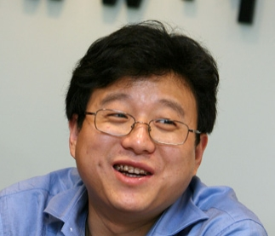
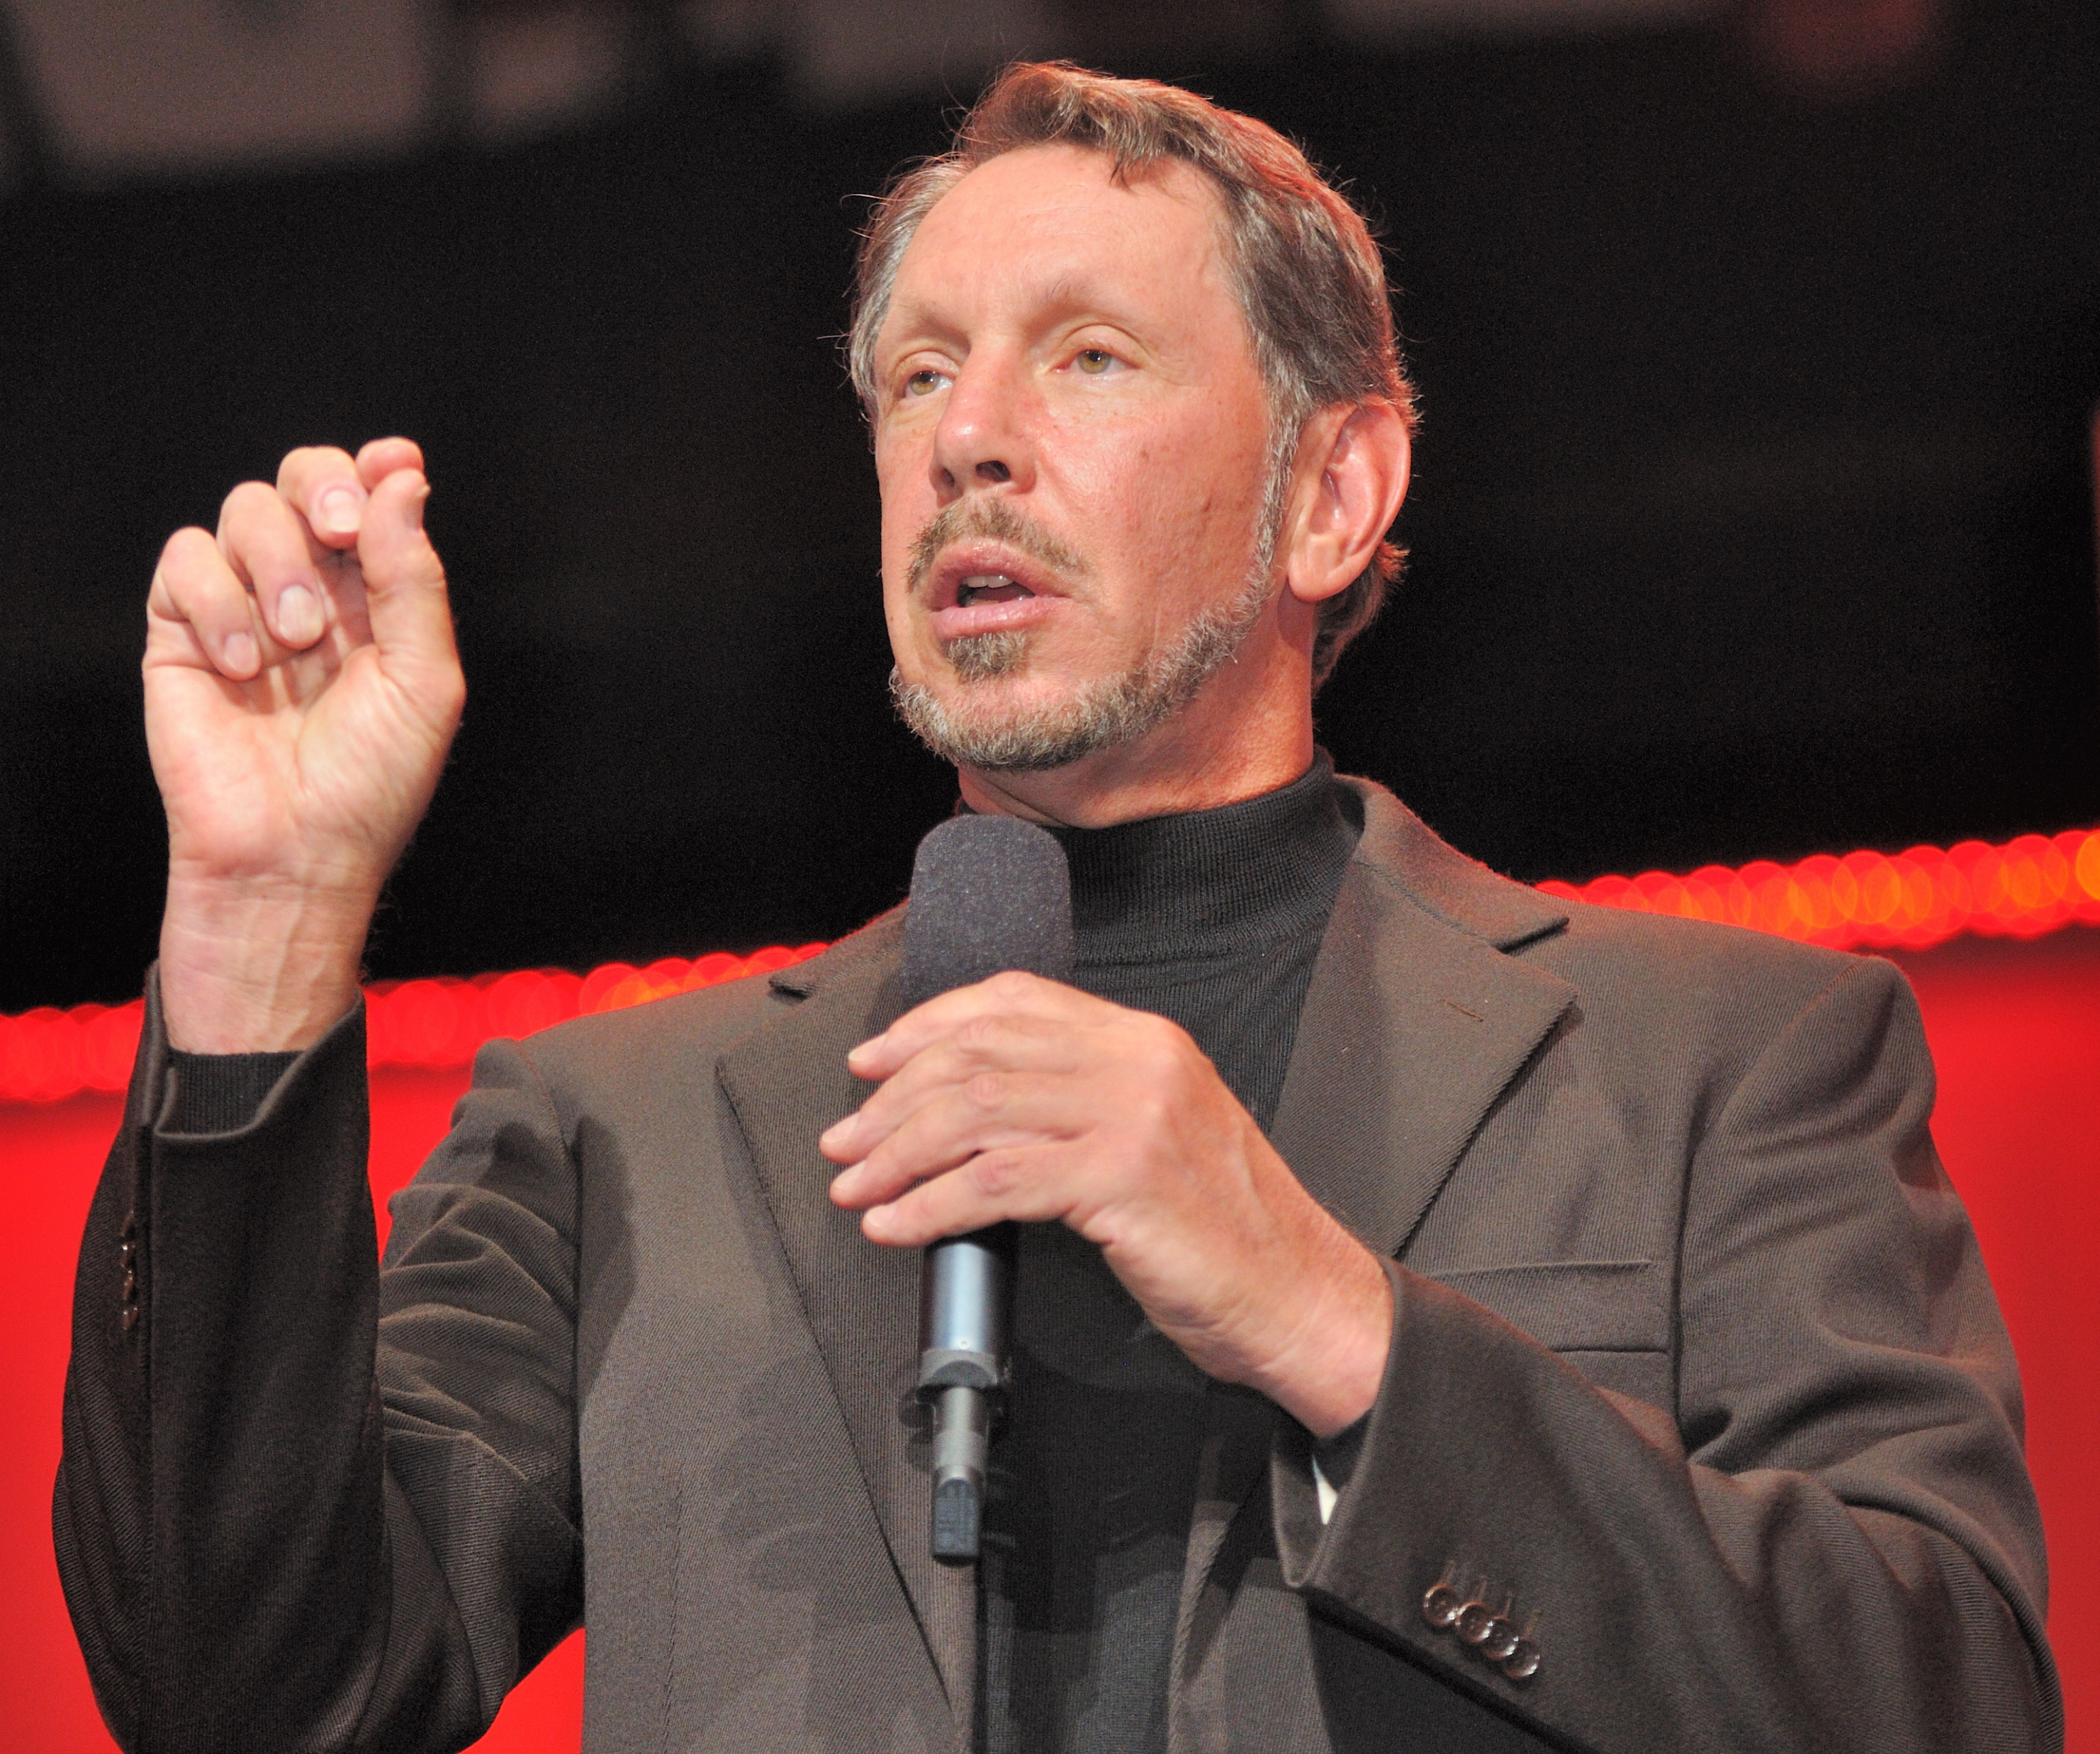
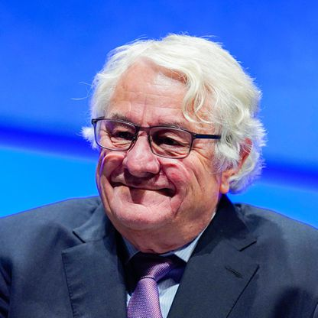
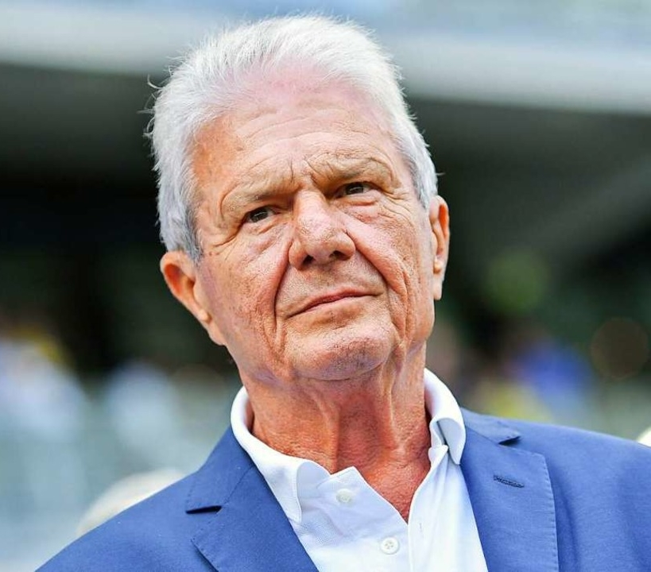
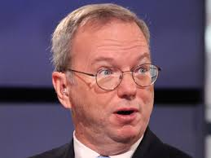
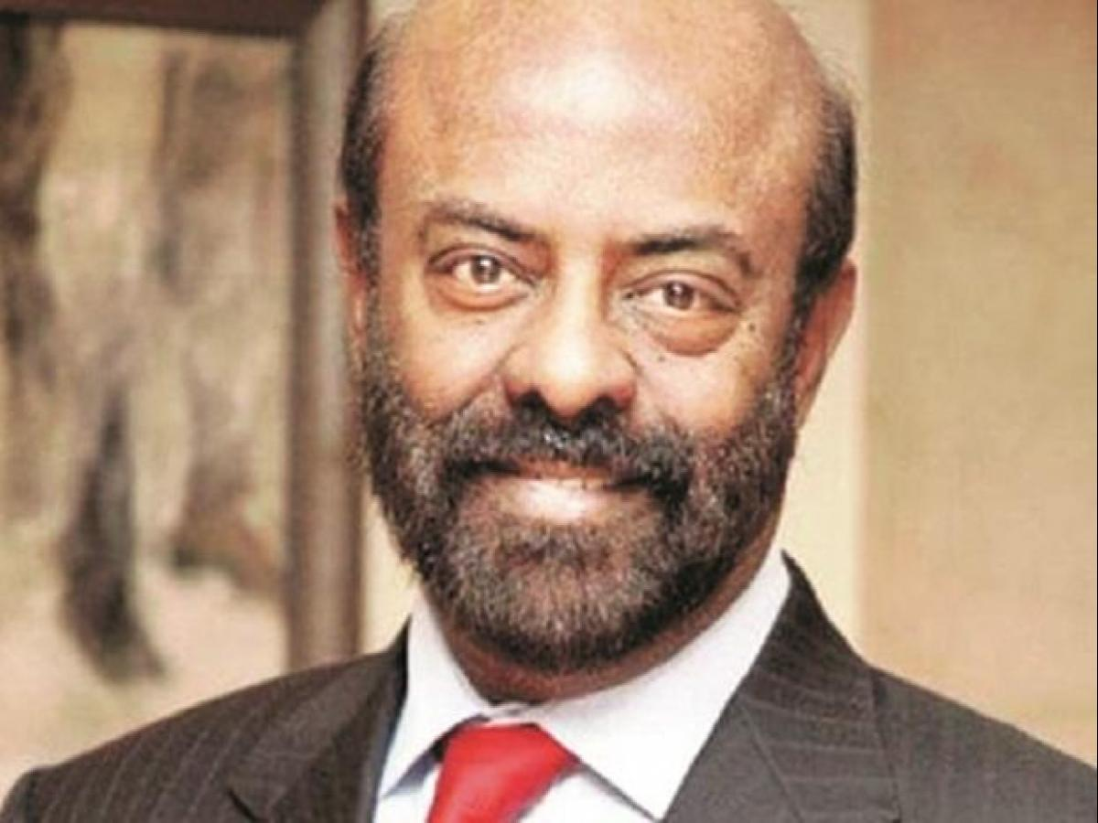
11.9B
USD
12.4B
USD
13B
USD
13B
USD
13.2B
USD
16.2B
USD
16.4B
USD
16.5B
USD
17B
USD
22.9B
USD
36B
USD
38.1B
USD
38.8B
USD
49.1B
USD
50.9B
USD
52.7B
USD
54B
USD
59B
USD
98B
USD
113B
USD
13.2B
USD
16.2B
USD
16.4B
USD
16.5B
USD
17B
USD
22.9B
USD
36B
USD
38.1B
USD
38.8B
USD
49.1B
USD
50.9B
USD
52.7B
USD
54B
USD
59B
USD
98B
USD
113B
USD
13.2B
USD
16.2B
USD
16.4B
USD
16.5B
USD
17B
USD
22.9B
USD
36B
USD
38.1B
USD
38.8B
USD
49.1B
USD
50.9B
USD
52.7B
USD
54B
USD
59B
USD
98B
USD
113B
USD
13.2B
USD
16.2B
USD
16.4B
USD
16.5B
USD
17B
USD
22.9B
USD
36B
USD
38.1B
USD
38.8B
USD
49.1B
USD
50.9B
USD
52.7B
USD
54B
USD
59B
USD
98B
USD
113B
USD
13.2B
USD
16.2B
USD
16.4B
USD
16.5B
USD
17B
USD
22.9B
USD
36B
USD
38.1B
USD
38.8B
USD
49.1B
USD
50.9B
USD
52.7B
USD
54B
USD
59B
USD
98B
USD
113B
USD
13.2B
USD
16.2B
USD
16.4B
USD
16.5B
USD
17B
USD
22.9B
USD
36B
USD
38.1B
USD
38.8B
USD
49.1B
USD
50.9B
USD
52.7B
USD
54B
USD
59B
USD
98B
USD
113B
USD
13.2B
USD
16.2B
USD
16.4B
USD
16.5B
USD
17B
USD
22.9B
USD
36B
USD
38.1B
USD
38.8B
USD
49.1B
USD
50.9B
USD
52.7B
USD
54B
USD
59B
USD
98B
USD
113B
USD
13.2B
USD
16.2B
USD
16.4B
USD
16.5B
USD
17B
USD
22.9B
USD
36B
USD
38.1B
USD
38.8B
USD
49.1B
USD
50.9B
USD
52.7B
USD
54B
USD
59B
USD
98B
USD
113B
USD
13.2B
USD
16.2B
USD
16.4B
USD
16.5B
USD
17B
USD
22.9B
USD
36B
USD
38.1B
USD
38.8B
USD
49.1B
USD
50.9B
USD
52.7B
USD
54B
USD
59B
USD
98B
USD
113B
USD
13.2B
USD
16.2B
USD
16.4B
USD
16.5B
USD
17B
USD
22.9B
USD
36B
USD
38.1B
USD
38.8B
USD
49.1B
USD
50.9B
USD
52.7B
USD
54B
USD
59B
USD
98B
USD
113B
USD
13.2B
USD
16.2B
USD
16.4B
USD
16.5B
USD
17B
USD
22.9B
USD
36B
USD
38.1B
USD
38.8B
USD
49.1B
USD
50.9B
USD
52.7B
USD
54B
USD
59B
USD
98B
USD
113B
USD
13.2B
USD
16.2B
USD
16.4B
USD
16.5B
USD
17B
USD
22.9B
USD
36B
USD
38.1B
USD
38.8B
USD
49.1B
USD
50.9B
USD
52.7B
USD
54B
USD
59B
USD
98B
USD
113B
USD
22.9B
USD
36B
USD
38.1B
USD
38.8B
USD
49.1B
USD
50.9B
USD
52.7B
USD
54B
USD
59B
USD
98B
USD
113B
USD
13.2B
USD
16.2B
USD
16.4B
USD
16.5B
USD
17B
USD
22.9B
USD
36B
USD
38.1B
USD
38.8B
USD
49.1B
USD
Shiv Nadar
Hasso Plattner
Zhang Zhidong
Dietmar Hopp
Eric Schmidt
Zhang Yiming
Laurene P. Jobs
Colin Z. Huang
William L. Ding
Michael Dell
Mackenzie Bezos
Ma Huateng
Jack Ma
Sergey Brin
Larry Page
Steve Ballmer
Mark Zuckerberg
Larry Ellison
Bill Gates
Jeff Bezos
Eric Schmidt
Zhang Yiming
Laurene P. Jobs
Colin Z. Huang
William L. Ding
Michael Dell
Mackenzie Bezos
Ma Huateng
Jack Ma
Sergey Brin
Larry Page
Steve Ballmer
Mark Zuckerberg
Larry Ellison
Bill Gates
Jeff Bezos
Eric Schmidt
Zhang Yiming
Laurene P. Jobs
Colin Z. Huang
William L. Ding
Michael Dell
Mackenzie Bezos
Ma Huateng
Jack Ma
Sergey Brin
Larry Page
Steve Ballmer
Mark Zuckerberg
Larry Ellison
Bill Gates
Jeff Bezos
Eric Schmidt
Zhang Yiming
Laurene P. Jobs
Colin Z. Huang
William L. Ding
Michael Dell
Mackenzie Bezos
Ma Huateng
Jack Ma
Sergey Brin
Larry Page
Steve Ballmer
Mark Zuckerberg
Larry Ellison
Bill Gates
Jeff Bezos
Eric Schmidt
Zhang Yiming
Laurene P. Jobs
Colin Z. Huang
William L. Ding
Michael Dell
Mackenzie Bezos
Ma Huateng
Jack Ma
Sergey Brin
Larry Page
Steve Ballmer
Mark Zuckerberg
Larry Ellison
Bill Gates
Jeff Bezos
Eric Schmidt
Zhang Yiming
Laurene P. Jobs
Colin Z. Huang
William L. Ding
Michael Dell
Mackenzie Bezos
Ma Huateng
Jack Ma
Sergey Brin
Larry Page
Steve Ballmer
Mark Zuckerberg
Larry Ellison
Bill Gates
Jeff Bezos
Eric Schmidt
Zhang Yiming
Laurene P. Jobs
Colin Z. Huang
William L. Ding
Michael Dell
Mackenzie Bezos
Ma Huateng
Jack Ma
Sergey Brin
Larry Page
Steve Ballmer
Mark Zuckerberg
Larry Ellison
Bill Gates
Jeff Bezos
Eric Schmidt
Zhang Yiming
Laurene P. Jobs
Colin Z. Huang
William L. Ding
Michael Dell
Mackenzie Bezos
Ma Huateng
Jack Ma
Sergey Brin
Larry Page
Steve Ballmer
Mark Zuckerberg
Larry Ellison
Bill Gates
Jeff Bezos
Eric Schmidt
Zhang Yiming
Laurene P. Jobs
Colin Z. Huang
William L. Ding
Michael Dell
Mackenzie Bezos
Ma Huateng
Jack Ma
Sergey Brin
Larry Page
Steve Ballmer
Mark Zuckerberg
Larry Ellison
Bill Gates
Jeff Bezos
Eric Schmidt
Zhang Yiming
Laurene P. Jobs
Colin Z. Huang
William L. Ding
Michael Dell
Mackenzie Bezos
Ma Huateng
Jack Ma
Sergey Brin
Larry Page
Steve Ballmer
Mark Zuckerberg
Larry Ellison
Bill Gates
Jeff Bezos
Eric Schmidt
Zhang Yiming
Laurene P. Jobs
Colin Z. Huang
William L. Ding
Michael Dell
Mackenzie Bezos
Ma Huateng
Jack Ma
Sergey Brin
Larry Page
Steve Ballmer
Mark Zuckerberg
Larry Ellison
Bill Gates
Jeff Bezos
Eric Schmidt
Zhang Yiming
Laurene P. Jobs
Colin Z. Huang
William L. Ding
Michael Dell
Mackenzie Bezos
Ma Huateng
Jack Ma
Sergey Brin
Larry Page
Steve Ballmer
Mark Zuckerberg
Larry Ellison
Bill Gates
Jeff Bezos
Michael Dell
Mackenzie Bezos
Ma Huateng
Jack Ma
Sergey Brin
Larry Page
Steve Ballmer
Mark Zuckerberg
Larry Ellison
Bill Gates
Jeff Bezos
Eric Schmidt
Zhang Yiming
Laurene P. Jobs
Colin Z. Huang
William L. Ding
Michael Dell
Mackenzie Bezos
Ma Huateng
Jack Ma
Sergey Brin
Here you write the “rules” or “terms” you used for your comparison

